Slide 1





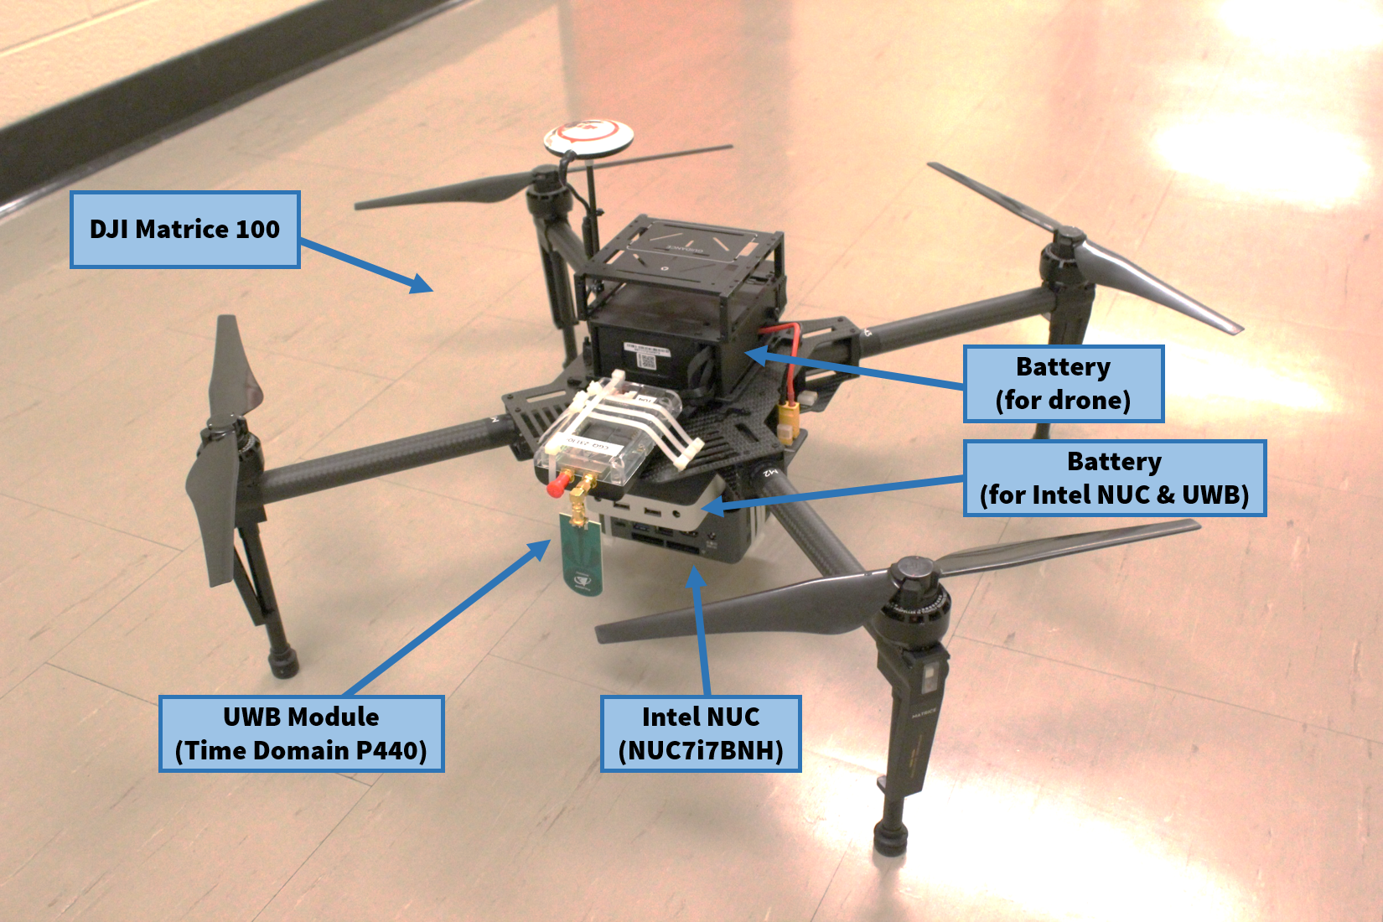
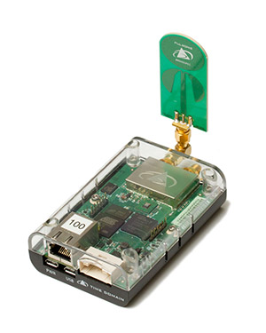
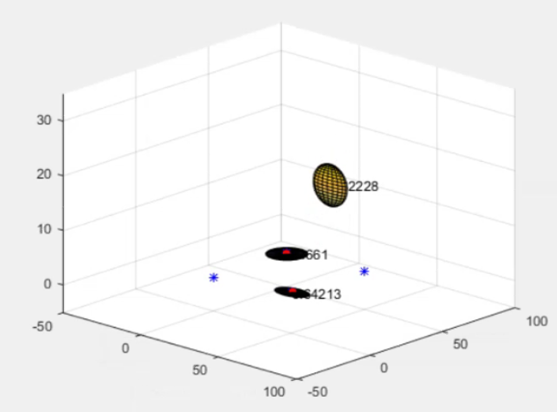
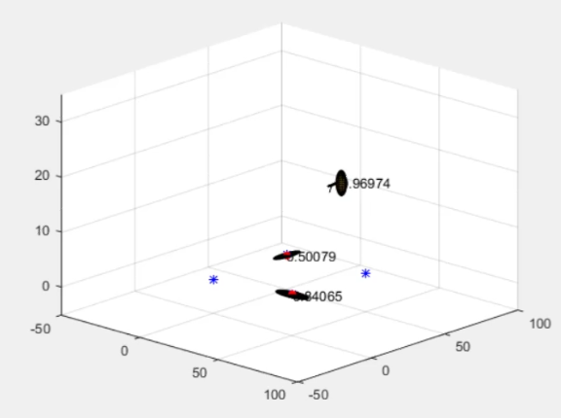
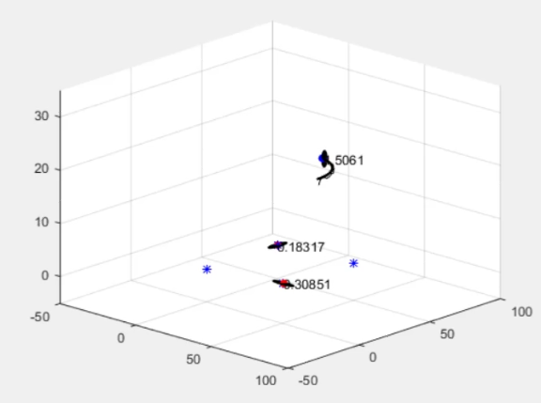
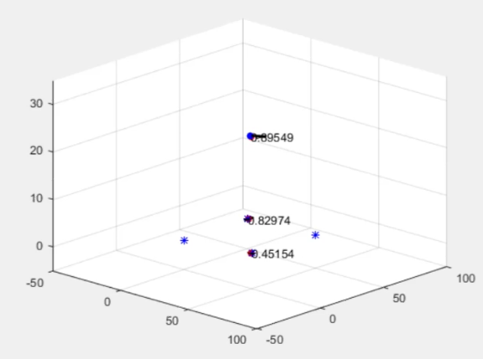
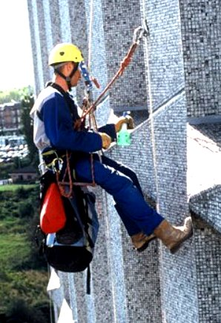
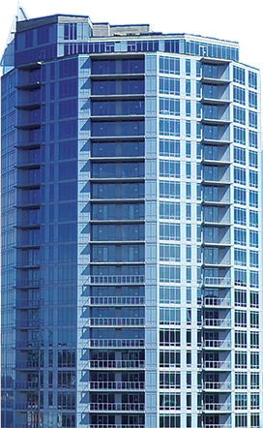
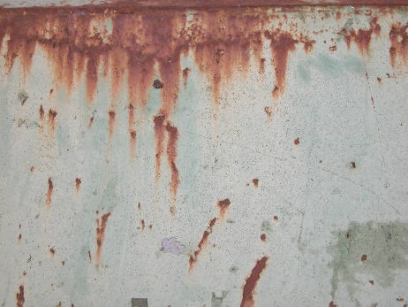
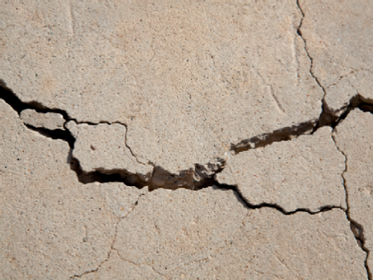
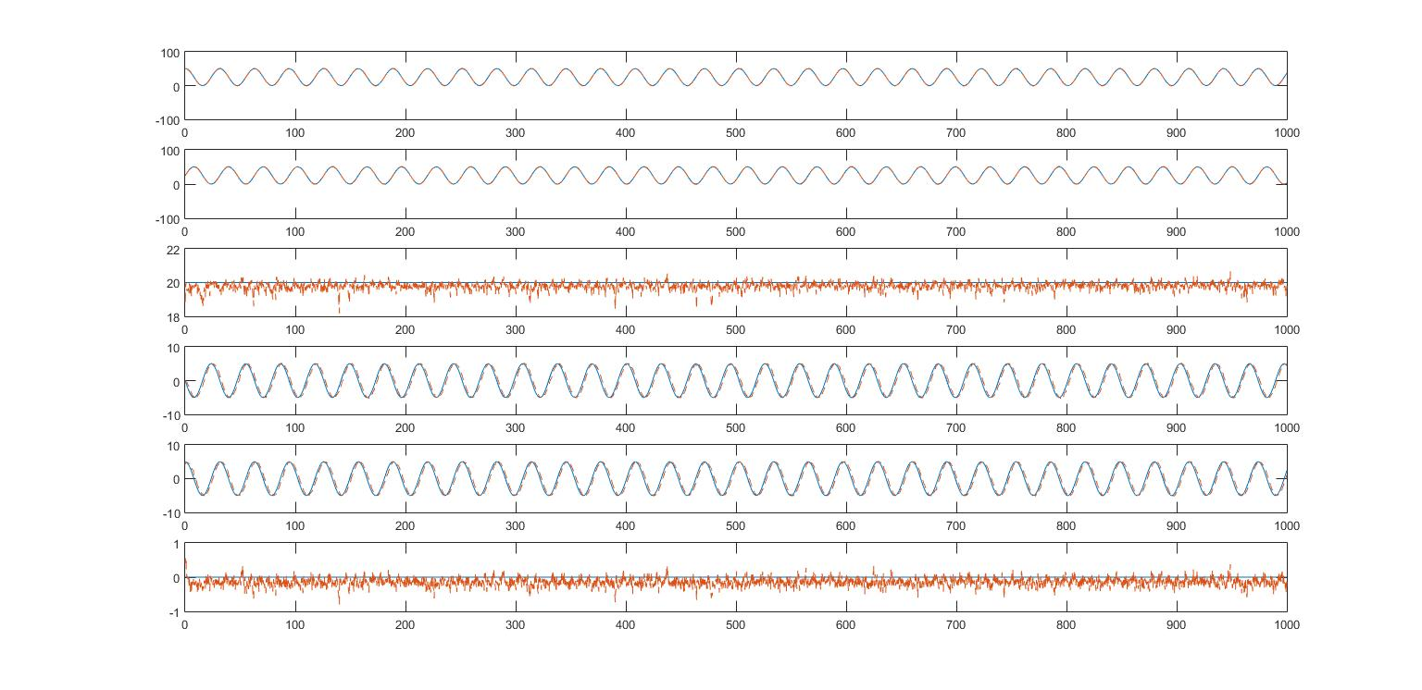
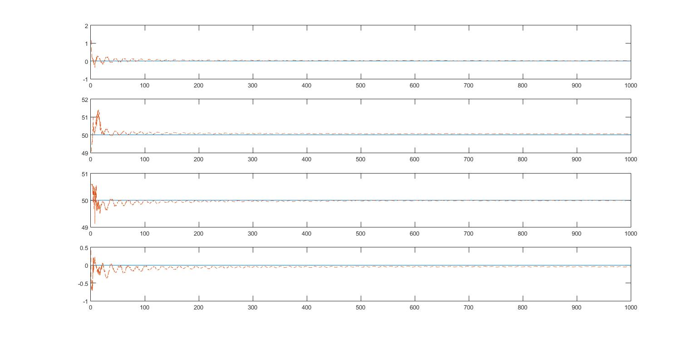
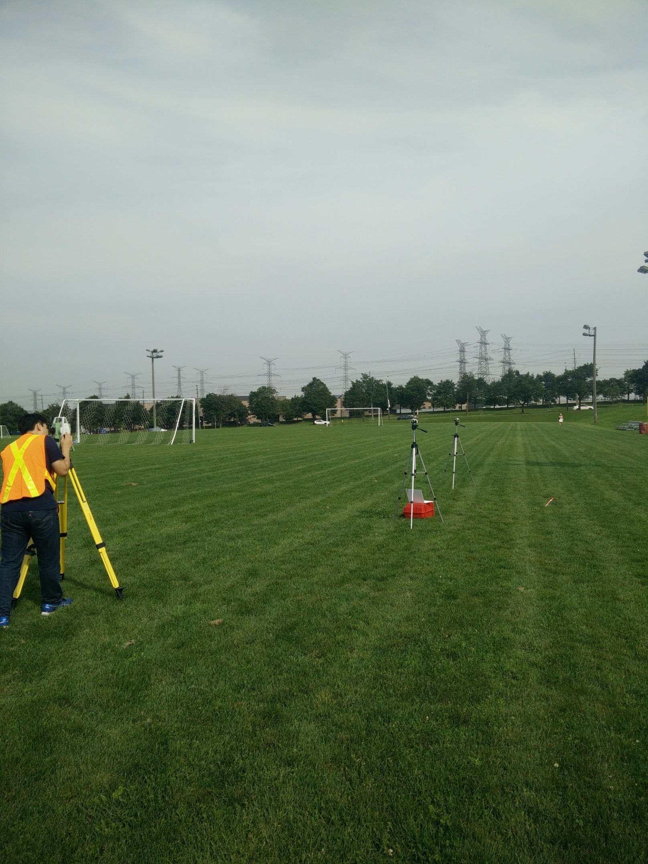
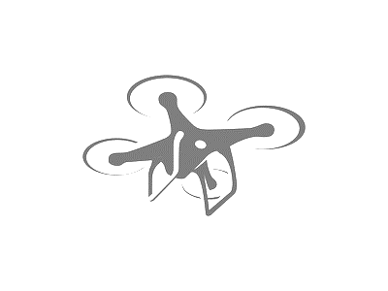
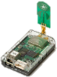
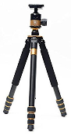
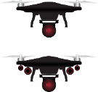
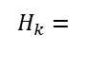
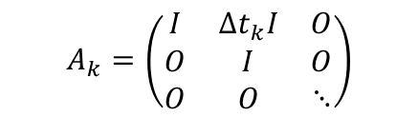
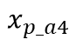

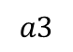
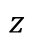


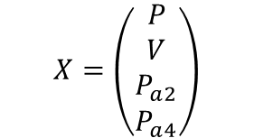
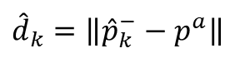
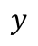

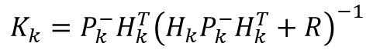
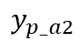
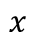
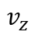

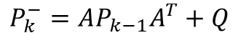
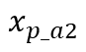
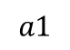
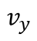
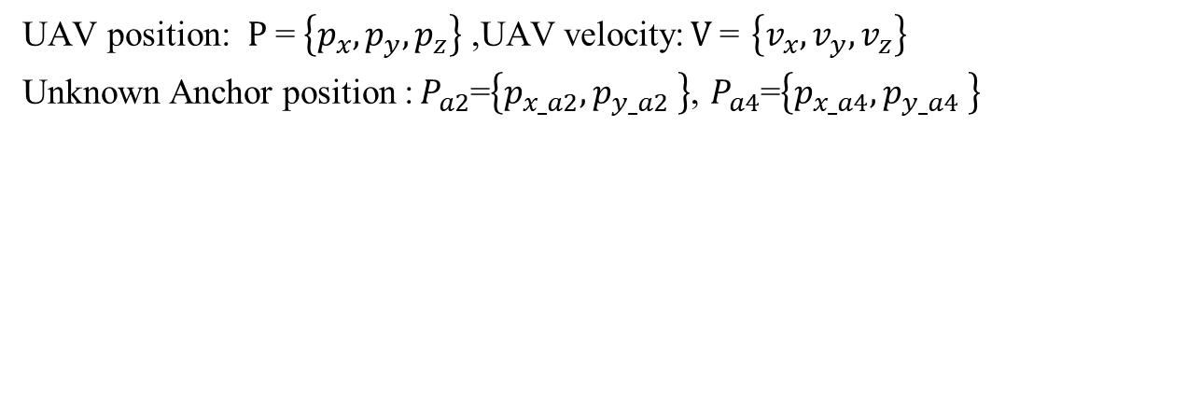
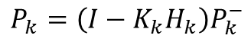
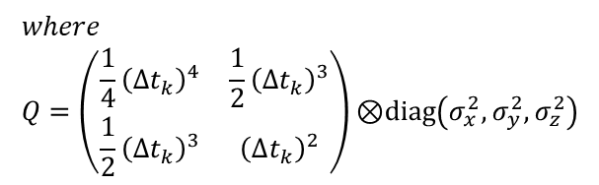
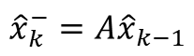
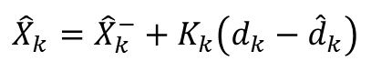
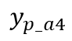
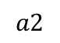
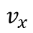
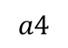
ULTRA-WIDEBAND-BASED RANGE-ONLY SLAM FOR
UAV LOCALIZATION IN OUTDOOR ENVIRONMEMT
Kunwoo Park, Jungwon Kang, Gunho Sohn
Dept. of Earth & Space Science & Engineering, York University Toronto, M3J1P3 Canada - (kunwoo7, jkang99 ,gsohn)@yorku.ca
Background
Hardware
Simulation Results of Range Only SLAM
A precision monitoring of the status of critical infrastructure on a timely manner is critical for public safety and economics. Today’s practice for inspecting critical infrastructure mainly rely on human forces, which is time-consuming, prone to errors and often put inspectors in dangerous situations. To address these issues, Unmanned Aerial Vehicle (UAV) is recently attracting large amount of attentions as an alternative solution to human-centric labors.
Platform: DJI Matrice 100
UWB module: Time Domain PulsOn 440
Dim/Weight | 56 x 103 x 18mm, 45g
Input Voltage | 4.5 to 48V DC
Interface | Ethernet, USB, Serial, SPI, CAN
Performance | accuracy: 2.1cm (clear line of sight) data rate: 125 Hz (max)
Max Operating Range | 300 m to 1100 m
$x, y,z$: UAV position(m) $v_{x},v_{y},v_{z}$: UAV velocity(m/s)
$x_{p_a2}$, $y_{p_a2}$, $x_{p_a4}$, $y_{p_a4}$: Anchor coordinates(m)
$$x$$
$$x_{p_a2}$$
UWB Ranging Calibration
$$y$$
$$y_{p_a2}$$
$$z$$
However, UAV mainly relies on consumer-grade lower-quality of positioning systems and has critical drawback to operate in downtown core areas where high-rise buildings often interfere signals from Global Navigation Satellite System (GNSS).
Reference(x) | UWB(y) | Difference (UWB-REF)
5046.88 | 5024.31 | -22.57
10019.61 | 9998.18 | -21.43
14987.38 | 14963.76 | -23.62
20030.77 | 20007.35 | -23.41
25012.76 | 24991.89 | -20.87
29969.53 | 29952.38 | -17.15
34949.02 | 34965.31 | 16.29
40072.37 | 40049.80 | -22.56
45059.26 | 45037.82 | -21.43
50031.28 | 50002.44 | -28.83
$$v_{x}$$
$$x_{p_a4}$$
$$v_{y}$$
$$v_{z}$$
$$y_{p_a4}$$
Ultra-Wideband(UWB) Based Localization
Ground truth value
Estimated value
X axis unit: s
Accuracy was measured between 500 and 1000 seconds after convergence.
Thus, there is high demand to increase UAV localization accuracy in GNSS-denial environments. One emerging solution is Ultra-Wideband (UWB) based localization due to its robustness to multipath and cm-level ranging error.
unit: mm
 | Error $x$ [m] | Error $y$ [m] | Error $z$ [m] | Error $v_{x}$[m/s] | Error $v_{y}$[m/s] | Error $v_{z}$[m/s] | Error$x_{p_a2}$[m] | Error$y_{p_a2}$[m] | Error$x_{p_a4}$[m] | Error $y_{p_a4}$[m]
Mean | -0.0042 | 0.0008 | 0.2004 | 0.0007 | -0.0039 | 0.1451 | -0.0025 | 0.0301 | 0.0028 | -0.0300
RMS Error | 0.6792 | 0.6584 | 0.2088 | 0.9997 | 0.9885 | 0.1193 | 0.0074 | 0.0073 | 0.0073 | 0.0072
UWB sensor measured about 21 mm longer than reference in average. This calibrated range is used for localization and SLAM algorithm.
Range Only SLAM based on EKF
Total error of UAV localization is 1.411 meter.
Total error of UAV velocity is 0.9681 meter.
Total error of UWB anchor position is 0.0103 meter.
D
0 ,50,1.25
50,50,2
$$a3$$
$$a4$$
Z_{W}
Z_{S}
UAV position: $P$= $\left\{p_{x},p_{y},p_{z}\right\}$ ,UAV velocity:$V$= $\left\{v_{x},v_{y},v_{z}\right\}$
Unknown Anchor position :$P_{a2}$=$\left\{p_{x_a2},p_{y_a2} \right\}$, $P_{a4}$=$\left\{p_{x_a4},p_{y_a4} \right\}$
Y_{W}
X_{W}
Y_{S}
X_{S}
UWB anchors
Initial location
50,25,20
Initial velocity
0,2,0
Conclusion
W
S
(height(z) of each anchor is assumed be known)
$$a1$$
$$a2$$
In this research we investigated the potential of using RO-SLAM for UAV localization. We calibrated UWB ranging error and perform simulation for RO-SLAM based on EKF. As a result, we got 0.68m of UAV positioning accuracy, 1.4m of UAV positioning accuracy, 0.96m of UAV velocity accuracy and 0.01m of anchor positioning accuracy. Our results show that it is possible to use RO-SLAM for UAV localization and anchor positioning.
Nevertheless, fixed UWB modules (anchors) have to be precisely installed to achieve localization by additional surveying work which hinders quick and easy use of the UWB based localization.
0,0,1
50,0,2.5
$$X=\left(\begin{aligned}P \\ V \\ P_{a2} \\ P_{a4}\end{aligned}\right)$$
$$A_{k}=\left(\begin{matrix}I & ∆t_{k}I & O \\ O & I & O \\ O & O & ⋱\end{matrix}\right)$$
$$where \\ Q=\left(\begin{matrix}\frac{1}{4}{\left(∆t_{k}\right)}^{4} & \frac{1}{2}{\left(∆t_{k}\right)}^{3} \\ \frac{1}{2}{\left(∆t_{k}\right)}^{3} & {\left(∆t_{k}\right)}^{2}\end{matrix}\right)\text{⊗}\text{diag}\left(σ_{x}^{2},σ_{y}^{2},σ_{z}^{2}\right)$$
$$Q_{k}=\left(\begin{matrix}Q & O & … \\ O & O & … \\ ⋮ & ⋮ & ⋱\end{matrix}\right)$$
Range-Only SLAM for UAV Localization
Guo, K 2016
Reference
Guo, K., Qiu, Z., Miao, C., Zaini, A. H., Chen, C. L., Meng, W., & Xie, L. (2016). Ultra-wideband-based localization for quadcopter navigation. Unmanned Systems, 4(01), 23-34.
Prediction
Correction
In this poster, we present UWB based Range Only Simultaneous Localization and Mapping (RO-SLAM) to facilitate quick installation of anchors and achieve UAV localization simultaneously. Approximate location of the UWB anchors and the UAV are continually updated based on the Extended Kalman Filter (EKF) using distance measurements. As a result, the coordinates of the UWB anchors converge within a certain amount of error and UAV localization is performed based on the distance measurement from the anchors.
anchor 1
$$\frac{1}{{\hat{d}}_{k}}\left[{\left({\hat{p}}_{k}^{−}−p^{1}\right)}^{T} 0 0 0 0 0 0 0\right]$$
$${\hat{x}}_{k}^{−}=A{\hat{x}}_{k−1}$$
$${\hat{d}}_{k}=\left\|{\hat{p}}_{k}^{−}−p^{a}\right\|$$
anchor 2
$$\frac{1}{{\hat{d}}_{k}}\left[{\left({\hat{p}}_{k}^{−}−p^{2}\right)}^{T} 0 0 0{ −\left({\hat{p}}_{k}^{−}−p^{2}\right)}^{T} 0 0\right]$$
$$P_{k}^{−}=AP_{k−1}A^{T}+Q$$
$$K_{k}=P_{k}^{−}H_{k}^{T}{\left(H_{k}P_{k}^{−}H_{k}^{T}+R\right)}^{−1}$$
$$H_{k}=$$
anchor 3
Acknowledgements
This project is partially supported by an NSERC (Natural Sciences and Engineering Research Council of Canada) grant in collaboration with ISW and CGQ.
$$\frac{1}{{\hat{d}}_{k}}\left[{\left({\hat{p}}_{k}^{−}−p^{3}\right)}^{T} 0 0 0 0 0 0 0 \right]$$
$${\hat{X}}_{k}={\hat{X}}_{k}^{−}+K_{k}\left(d_{k}−{\hat{d}}_{k}\right)$$
anchor 4
$$P_{k}=\left(I−K_{k}H_{k}\right)P_{k}^{−}$$
$$\frac{1}{{\hat{d}}_{k}}\left[{\left({\hat{p}}_{k}^{−}−p^{4}\right)}^{T} 0 0 0{ 0 0−\left({\hat{p}}_{k}^{−}−p^{4}\right)}^{T} \right]$$

